Slide 1


ITI Examination System
Information Technology Institute

Slide 2
AGENDA
01.
02.
03.
Objective
Database Building
Stored Procedures
04.
05.
06.
Reports
Dashboards
Conclusion

Slide 3





Meet Our Team
Hamdy Magdy
Mostafa Khaled
Mosaab Mahmoud
Fatma Mohamed
Mona Rizq

Slide 4






Objective

Slide 5





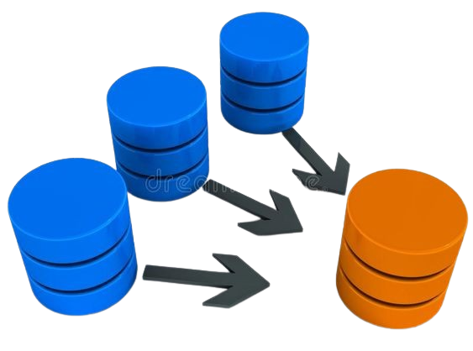
Project Stages
Reports &
Dashboard
Database Design
1
Generate
Data
5
2
Documentation
4
6
3
Database Implementation
Stored Procedures

Slide 6
02. Database Building

Slide 7
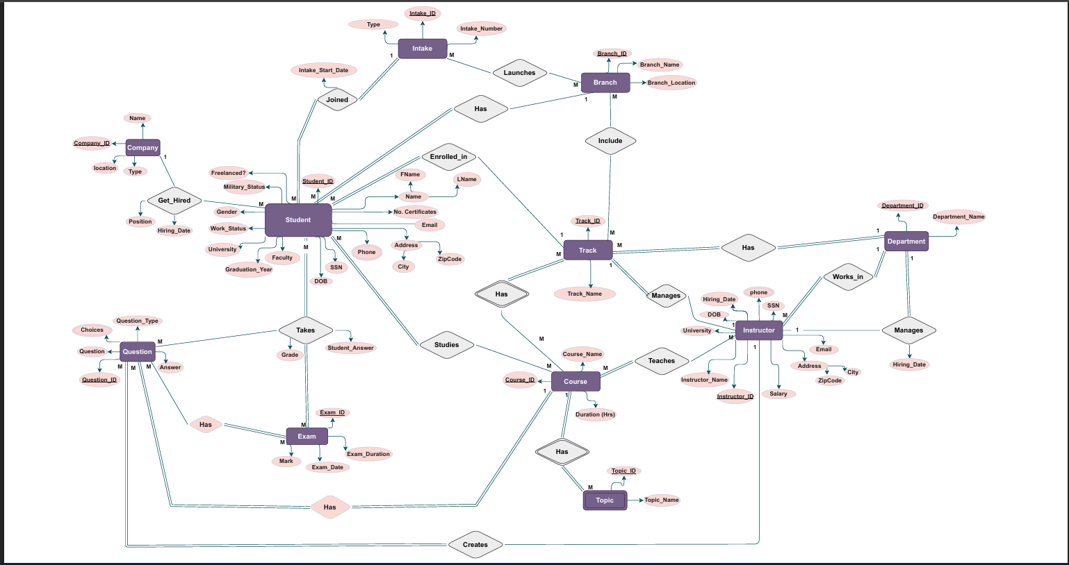
ERD

Slide 8
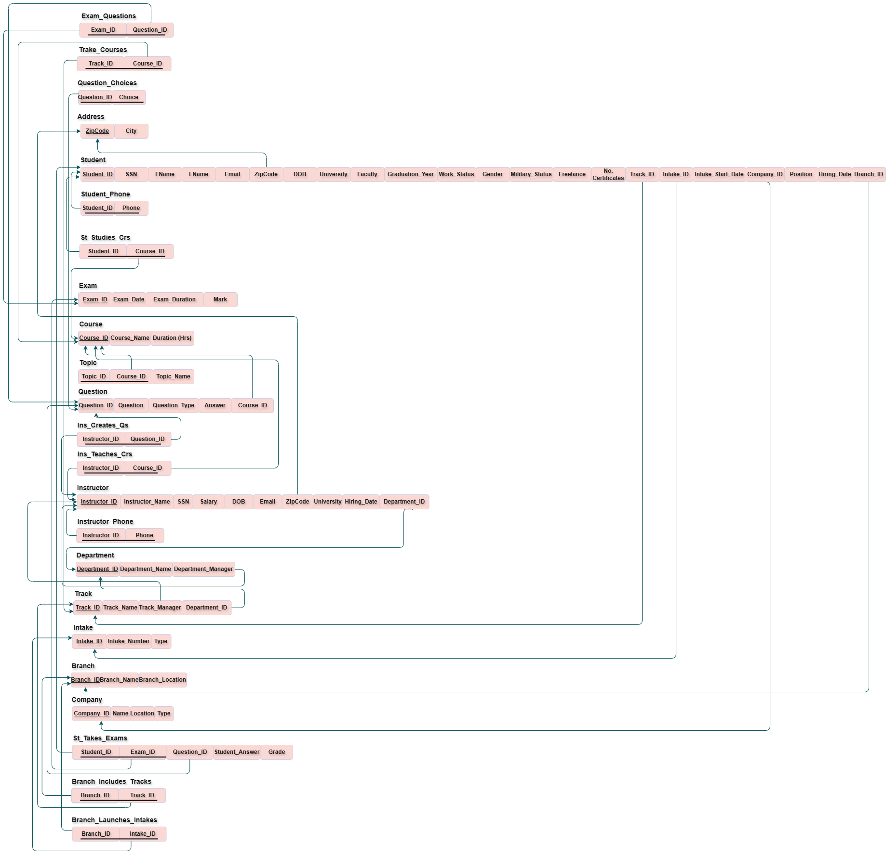
Mapping

Slide 9
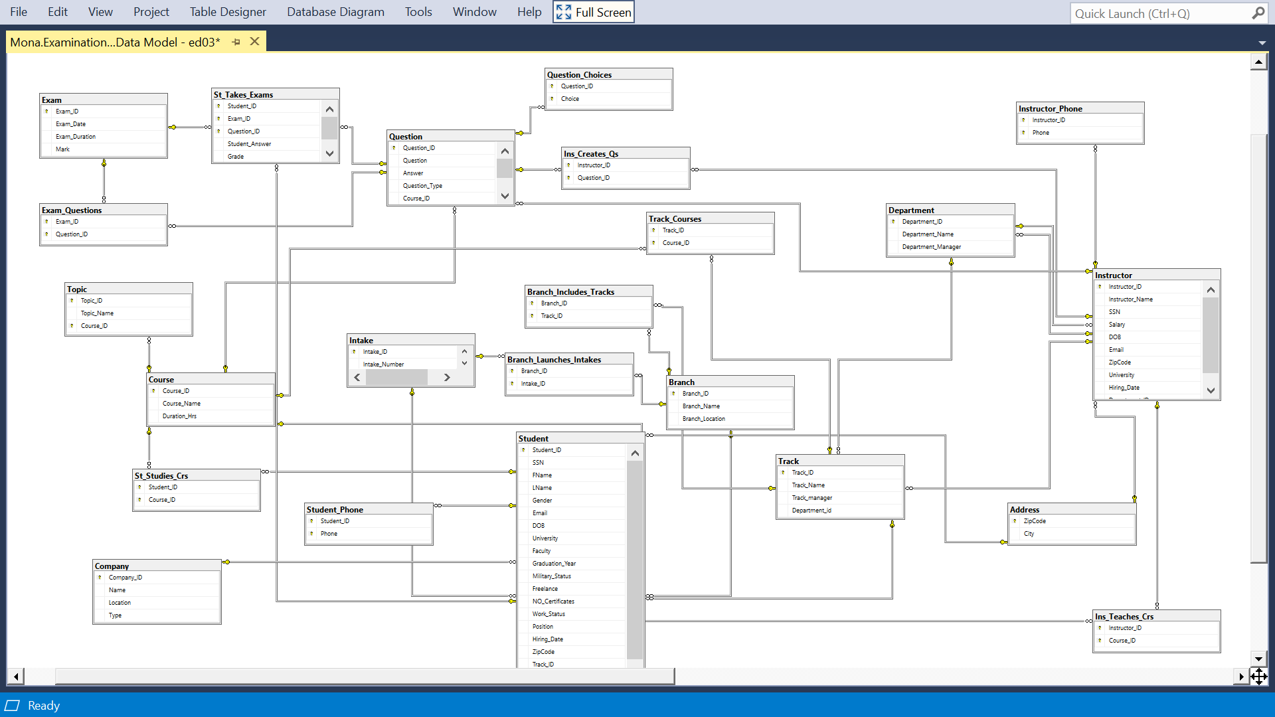
Schema

Slide 10
03. Stored Procedures

Slide 11
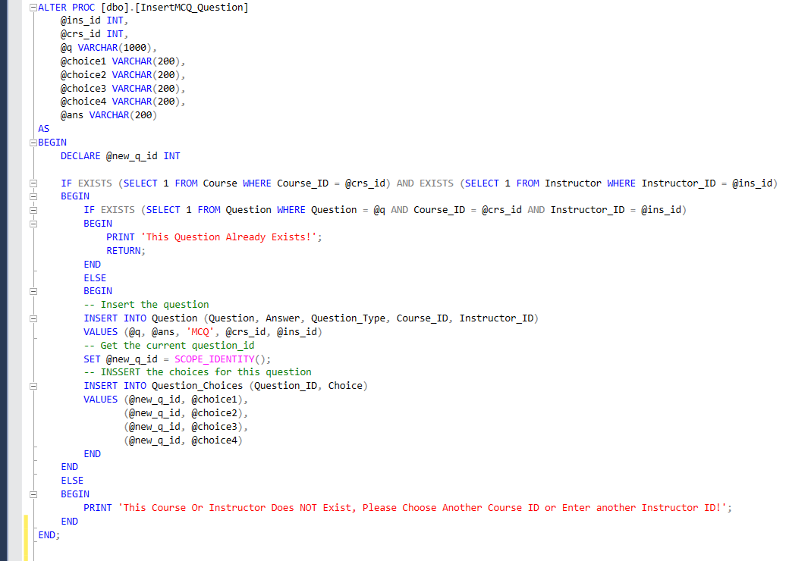
Insert Question

Slide 12
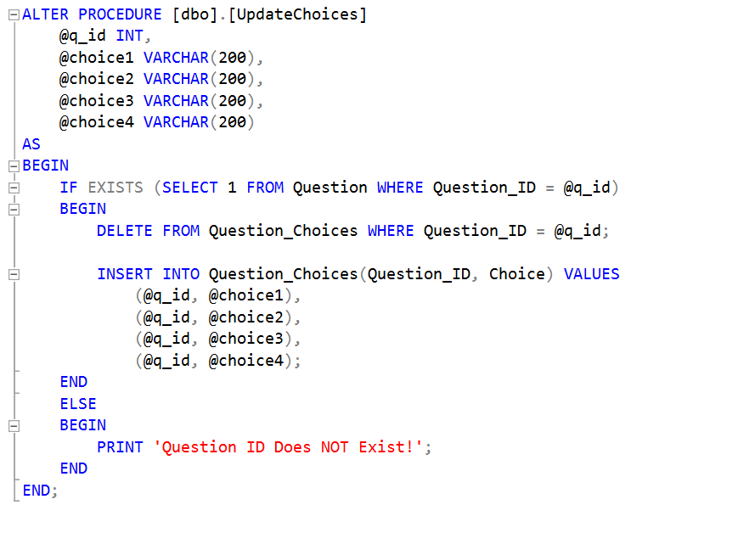
Update Question

Slide 13
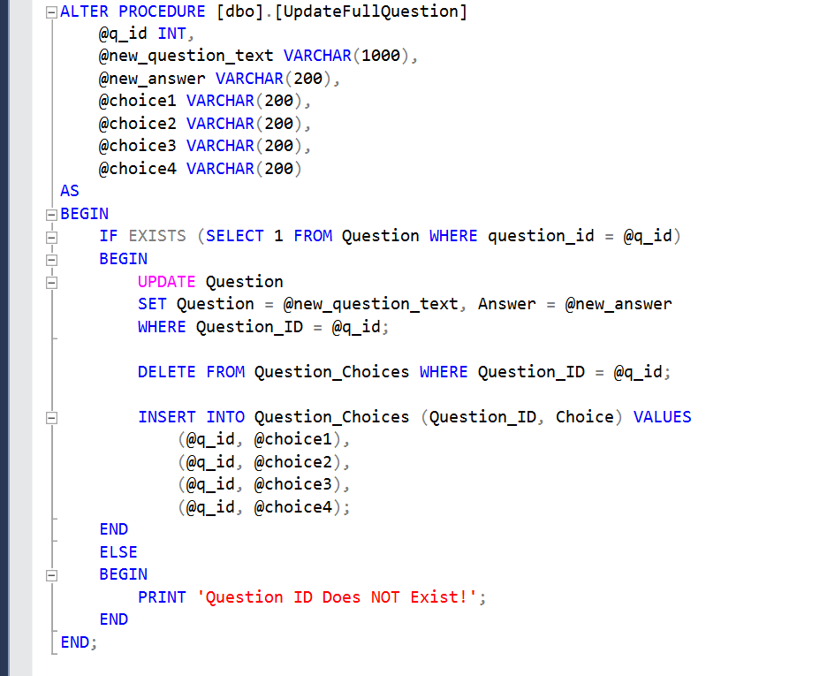
Update Full Question

Slide 14
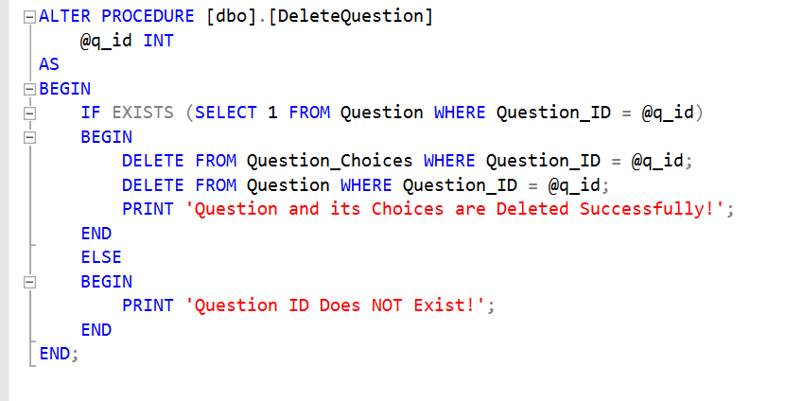
Delete Question

Slide 15
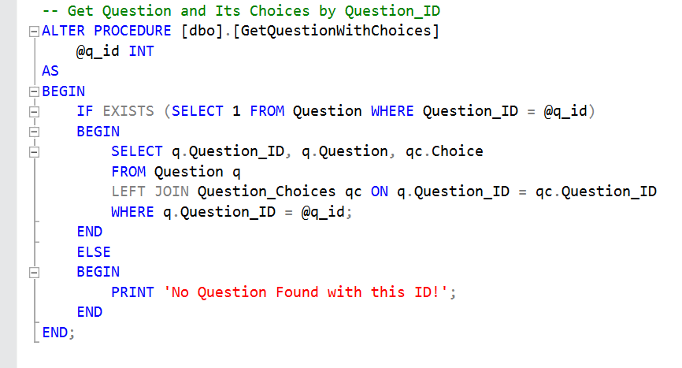
Select Question

Slide 16
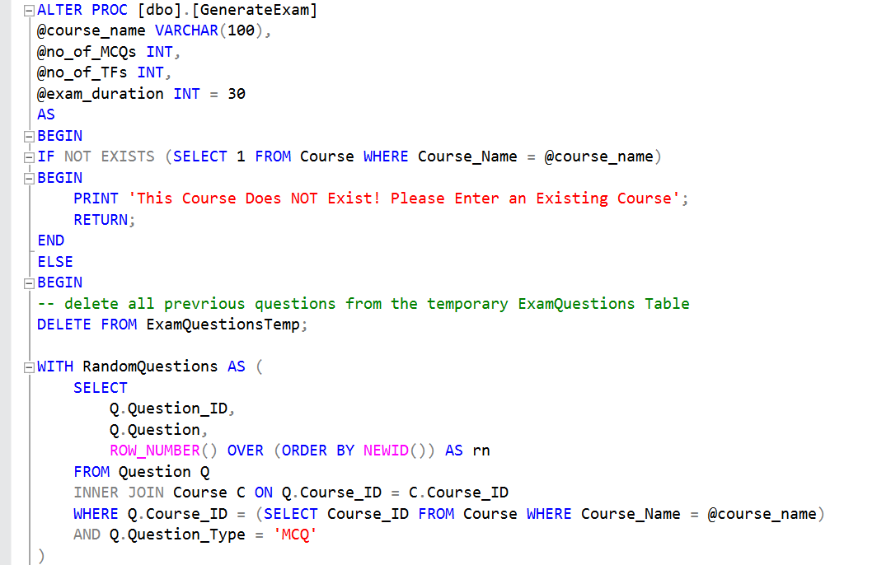
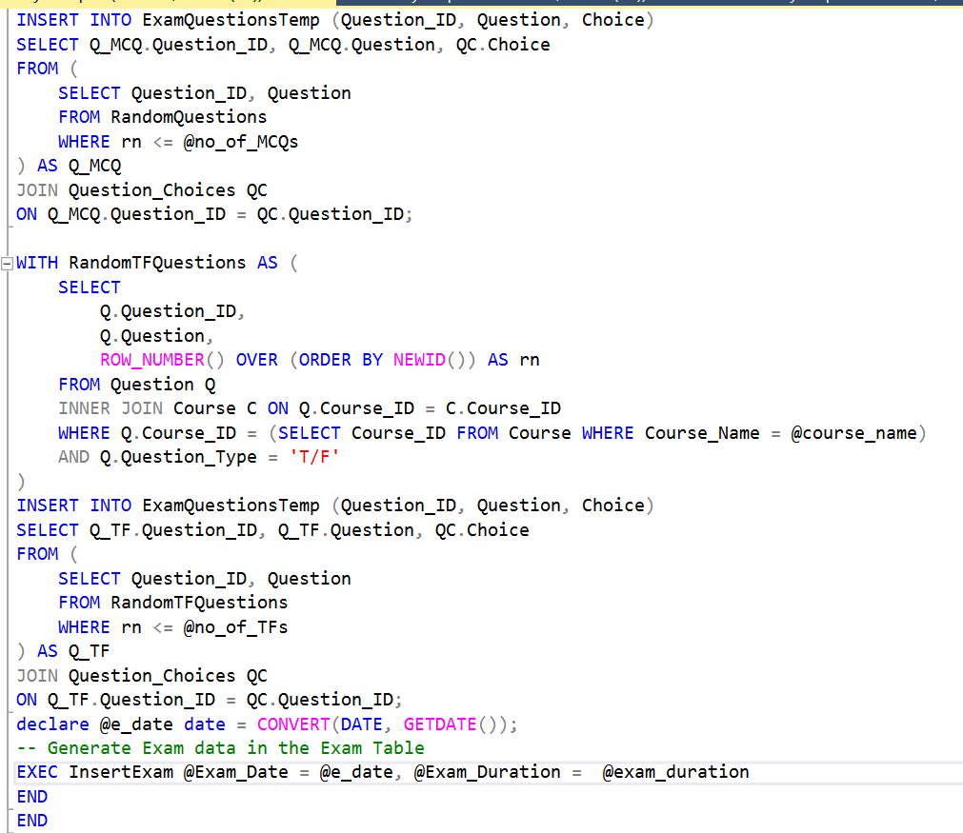
Generate Exam

Slide 17
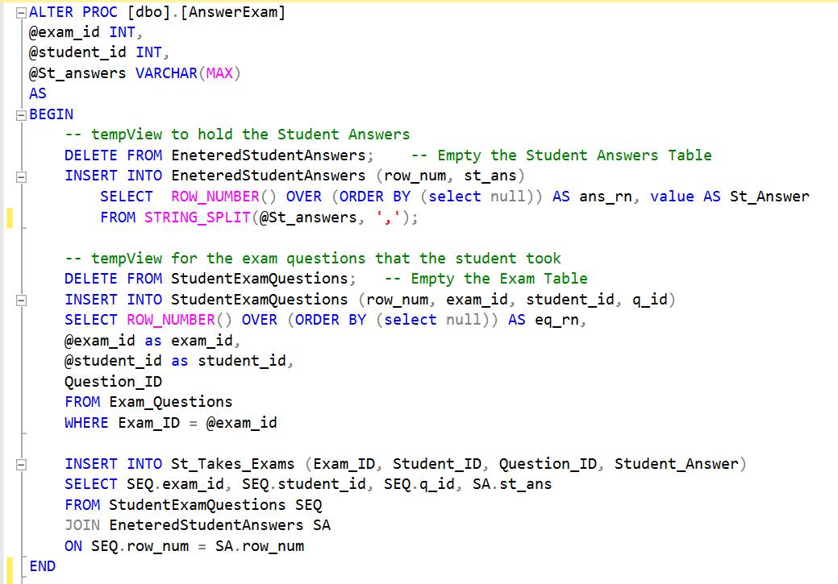
Answer Exam

Slide 18
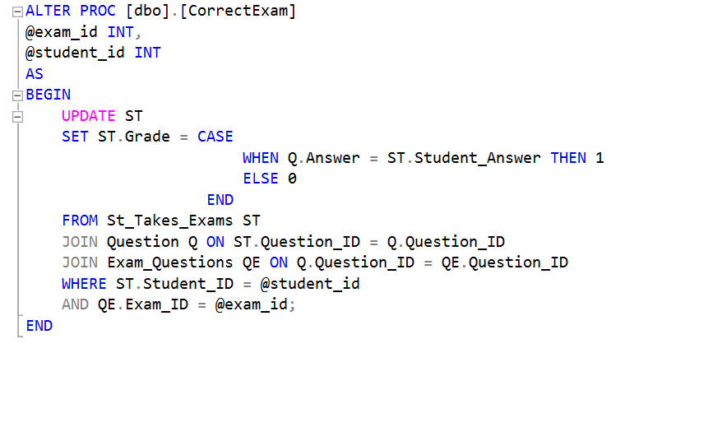
Correct Exam

Slide 19
04. Reports

Slide 20
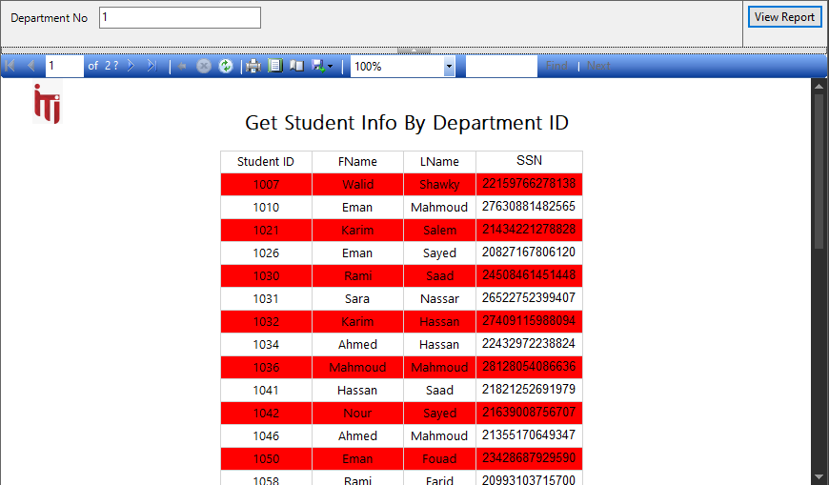
Get Student Info

Slide 21
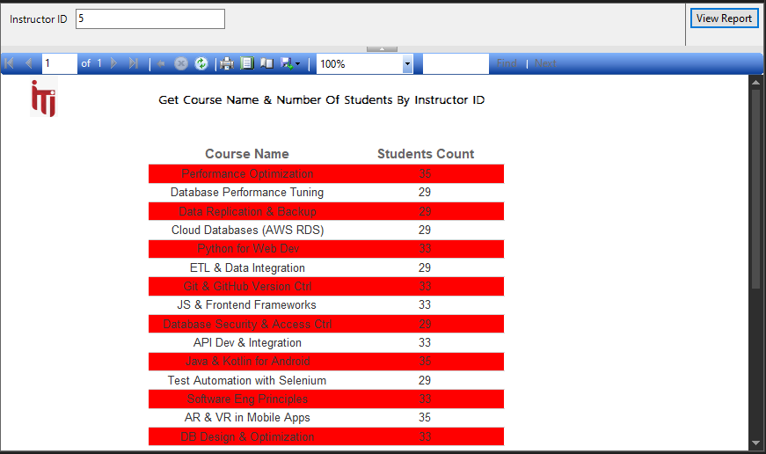
Get Course Info

Slide 22
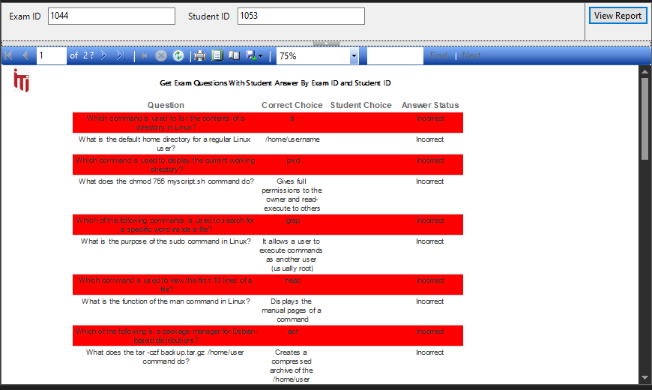
Get Exam Info

Slide 23
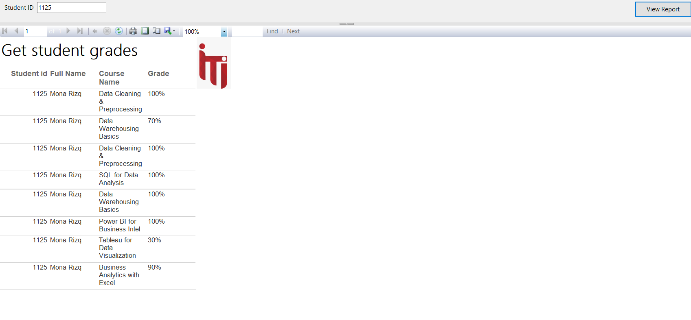
Get Student Grades

Slide 24
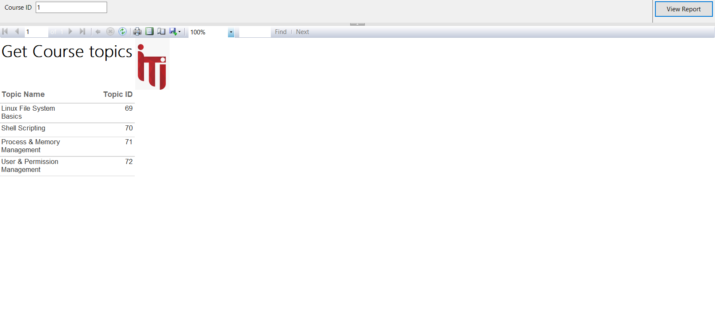
Get Course Topics

Slide 25
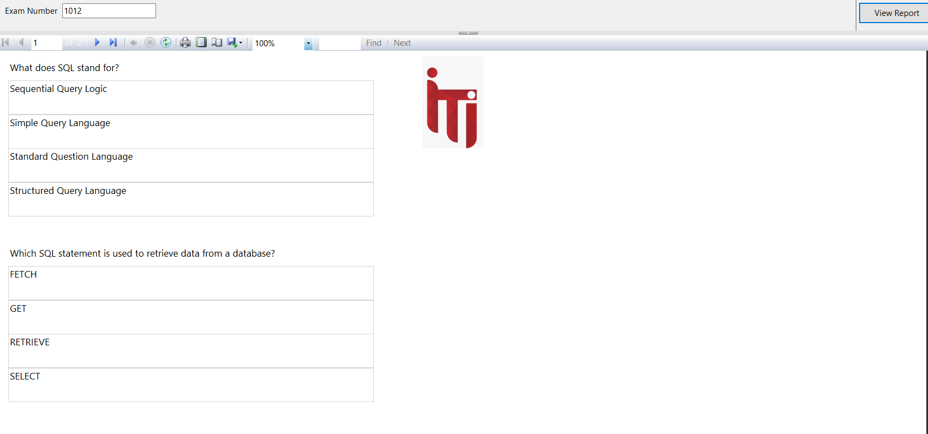
Get Exam Questions

Slide 26
05. Dashboards

Slide 27
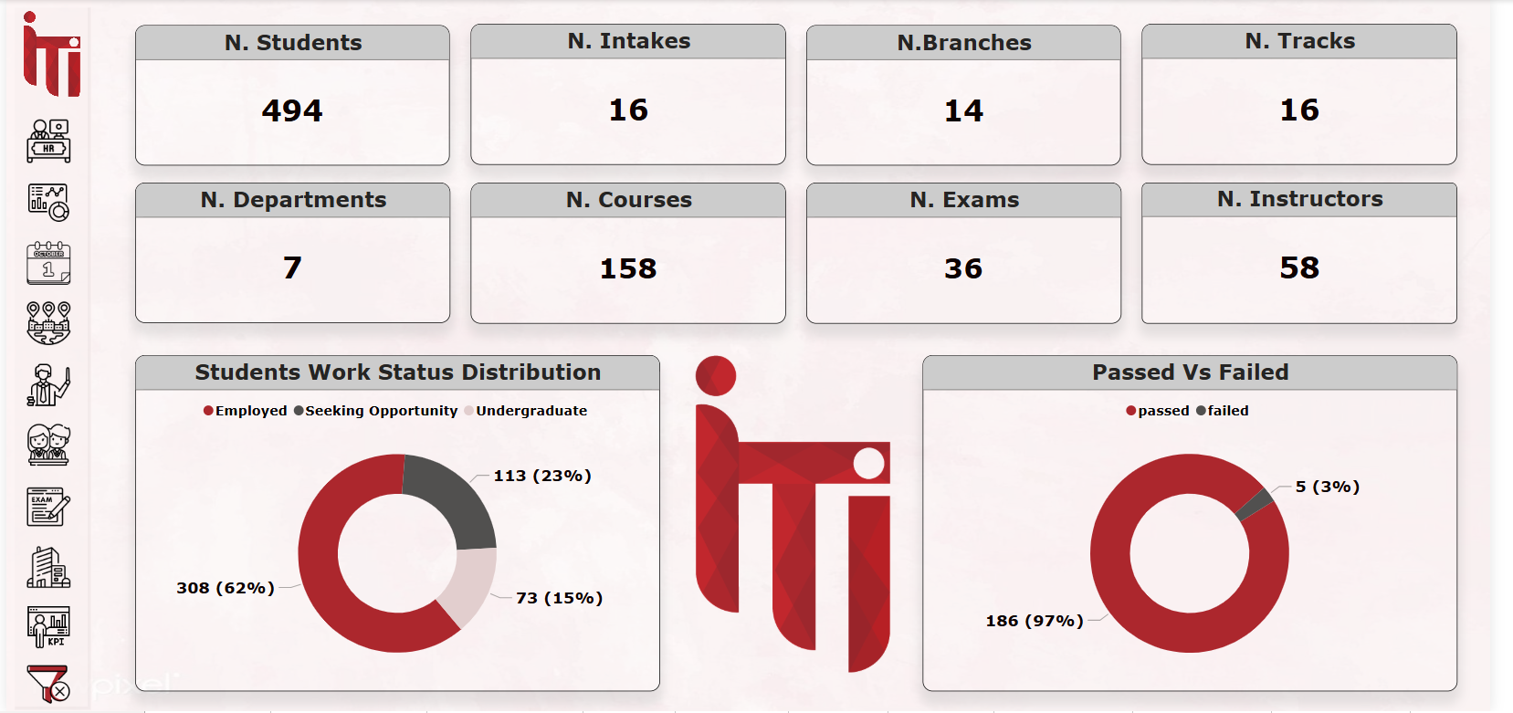
Overview

Slide 28
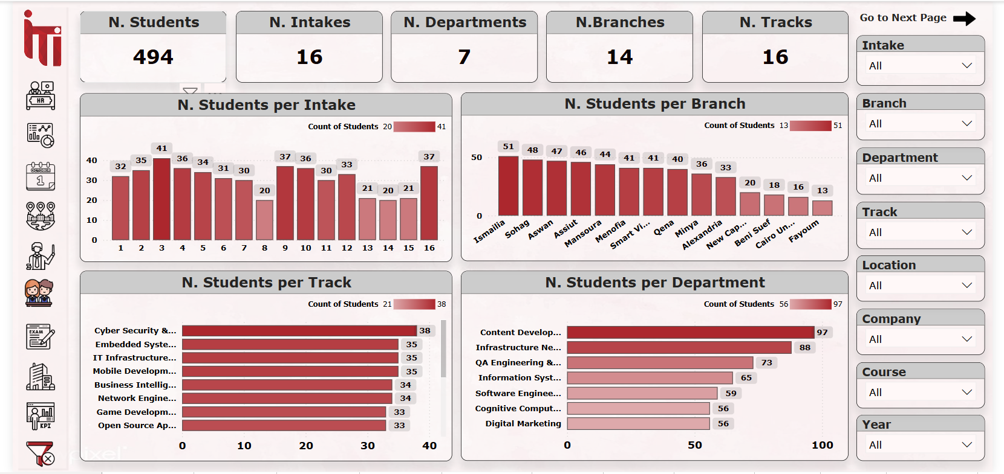
Student

Slide 29
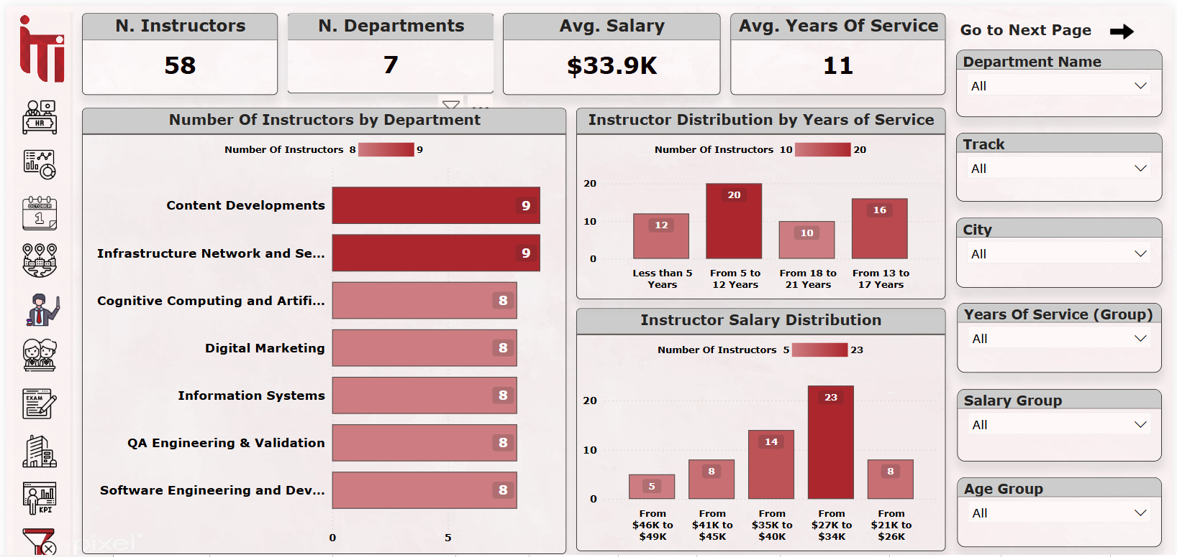
Instructor

Slide 30
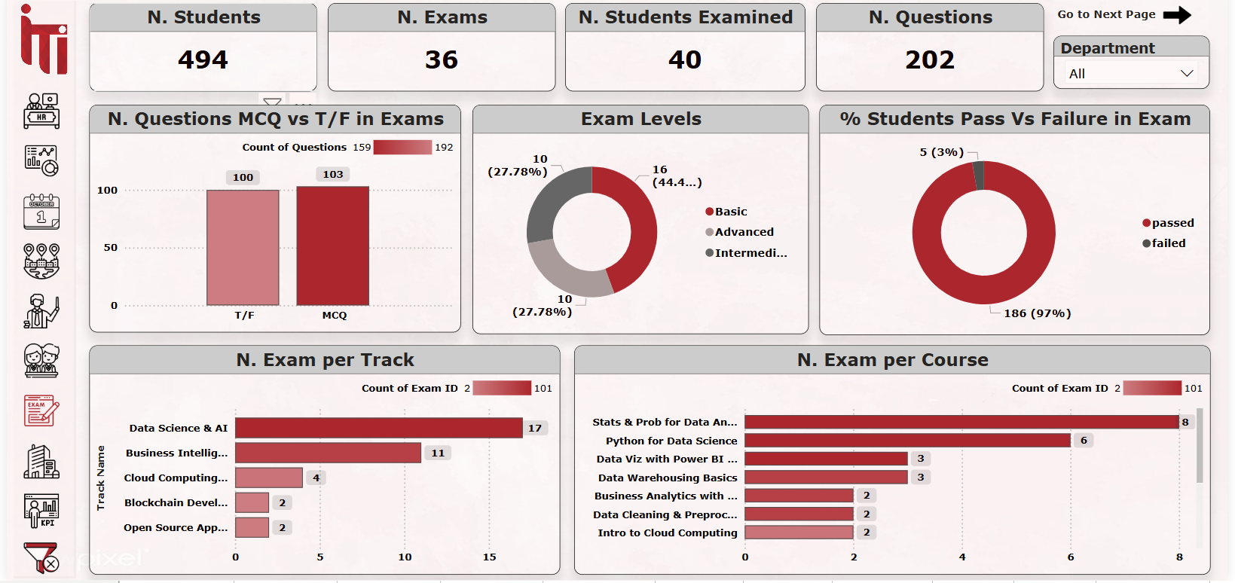
Exam

Slide 31
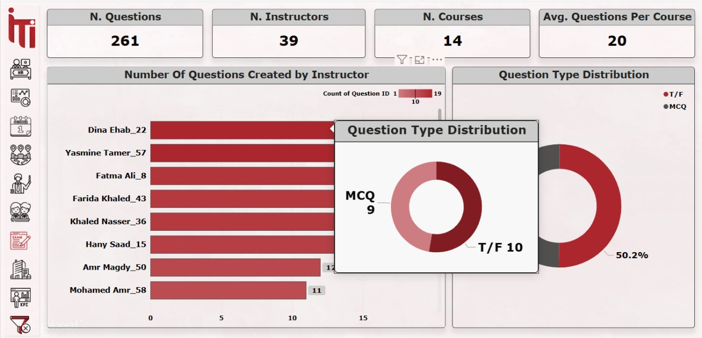
Questions

Slide 32
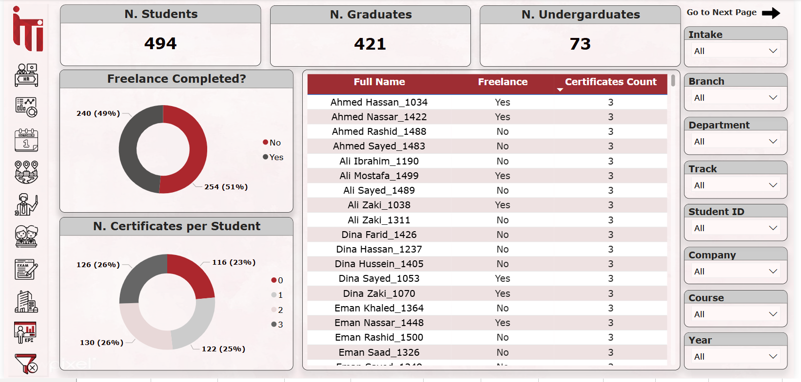
KPIs

Slide 33
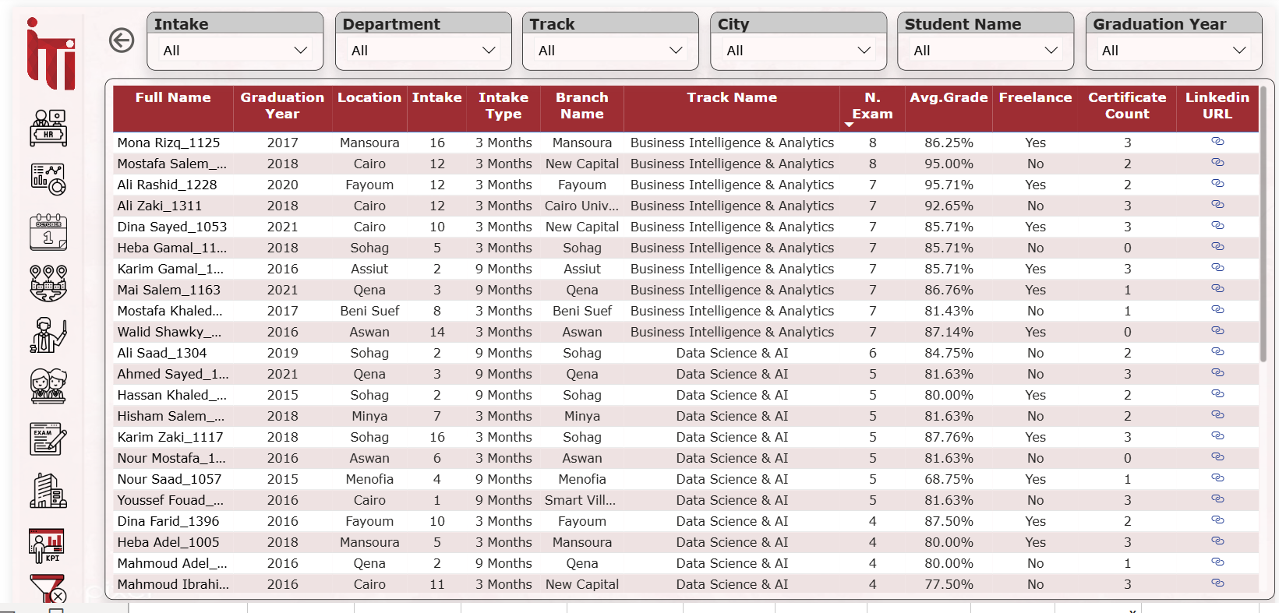
KPIs (cont’d)

Slide 34
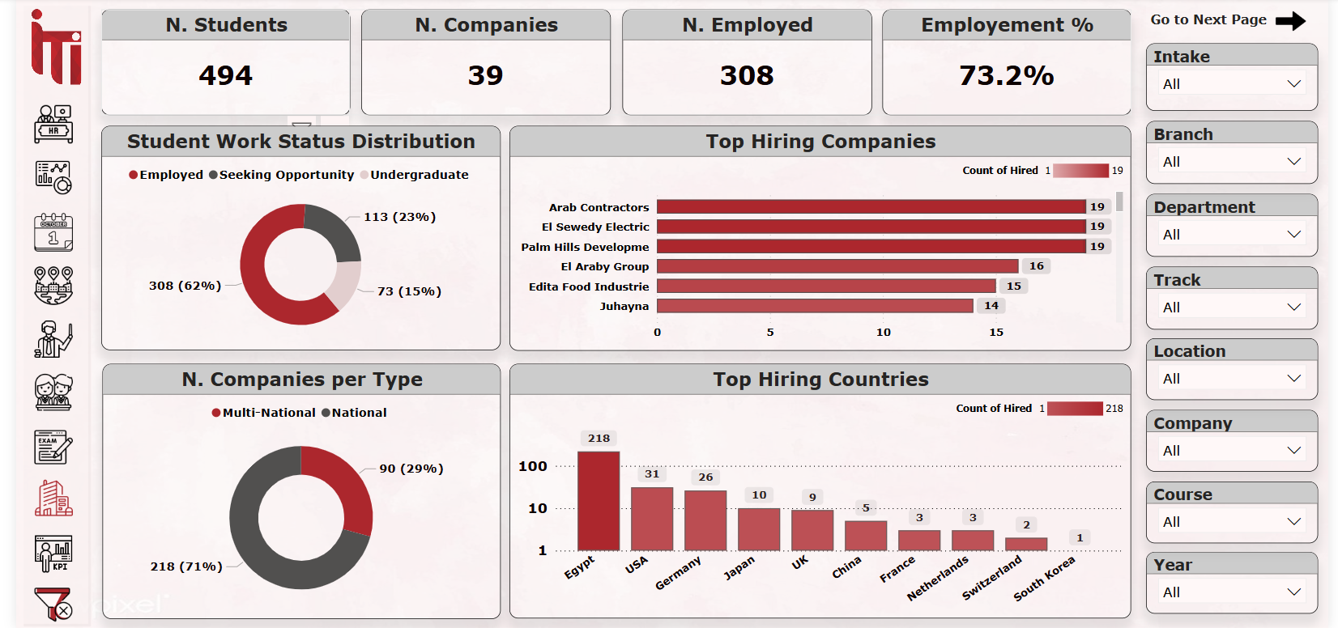
Employment Status

Slide 35
06. Conclusion

Slide 36
ITI Examination System enhances academic tracking and decision-making through two key insights:
Efficient Data Management & Integration: The ERD and database structure ensure seamless data flow between students, exams, instructors, and institutions, improving accuracy and accessibility.
Data-Driven Insights & Visualization: SSRS reports and dashboards provide real-time analytics, helping educators monitor performance trends and make informed decisions.
This system optimizes the examination process, making it more efficient, and insightful.

